Slide 1
AF1001 Fundamentals of Accounting (BSE-3rd Semester)
Mr. Sami Ullah
Lecturer
NUCES -FAST Peshawar

Slide 2
Depreciation
Depreciation is the process of allocating to expense the cost of a plant asset over its useful (service) life in a rational and systematic manner. Cost allocation enables companies to properly match expenses with revenues in accordance with the expense recognition principle, as shown in Illustration 10-5.

Slide 3

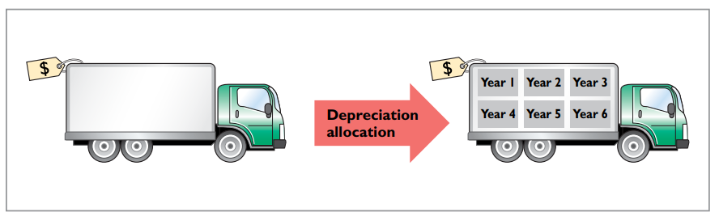

Slide 4
It is important to understand that depreciation is a process of cost allocation. It is not a process of asset valuation.
Depreciation applies to three classes of plant assets: land improvements, buildings, and equipment.
Depreciation does not apply to land because its usefulness and revenue-producing ability generally remain intact over time.

Slide 5
During a depreciable asset’s useful life, its revenue-producing ability declines because of wear and tear.
Revenue-producing ability may also decline because of obsolescence. Obsolescence is the process of becoming out of date before the asset physically wears out.
Recognizing depreciation on an asset does not result in an accumulation of cash for replacement of the asset. The balance in Accumulated Depreciation represents the total amount of the asset’s cost that the company has charged to expense.

Slide 6

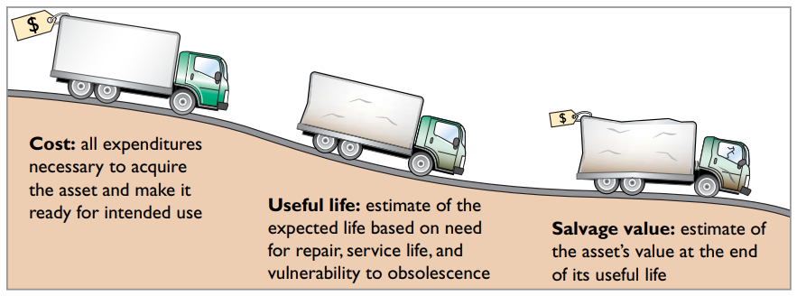
Factors in Computing Depreciation
Three factors affect the computation of depreciation, as shown in Illustration 10-6.

Slide 7
1. Cost. Earlier, we explained the issues affecting the cost of a depreciable asset. Recall that companies record plant assets at cost, in accordance with the historical cost principle.
2. Useful life. Useful life is an estimate of the expected productive life, also called service life, of the asset for its owner. Useful life may be expressed in terms of time, units of activity (such as machine hours), or units of output.
3. Salvage value. Salvage value is an estimate of the asset’s value at the end of its useful life. This value may be based on the asset’s worth as scrap or on its expected trade-in value. Like useful life, salvage value is an estimate. In making the estimate, management considers how it plans to dispose of the asset and its experience with similar assets.

Slide 8
Depreciation Methods
Depreciation is generally computed using one of the following methods:
1. Straight-line
2. Units-of-activity
3. Declining-balance

Slide 9

We will compare the three depreciation methods using the following data for a small delivery truck purchased by Barb’s Florists on January 1, 2017.

Slide 10
STRAIGHT-LINE METHOD
Under the straight-line method, companies expense the same amount of depreciation for each year of the asset’s useful life. It is measured solely by the passage of time.
To compute depreciation expense under the straight-line method, companies need to determine depreciable cost.
Depreciable cost is the cost of the asset less its salvage value. It represents the total amount subject to depreciation.

Slide 11
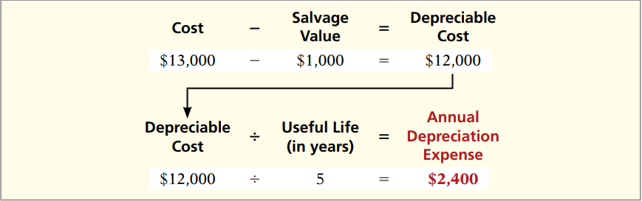
Under the straight-line method, to determine annual depreciation expense, we divide depreciable cost by the asset’s useful life. Illustration 10-9 shows the computation of the first year’s depreciation expense for Barb’s Florists.

Slide 12
Alternatively, we also can compute an annual rate of depreciation. In this case, the rate is 20% (100% / 5 years). When a company uses an annual straight-line rate, it applies the percentage rate to the depreciable cost of the asset. Illustration 10-10 shows a depreciation schedule using an annual rate.

Slide 13
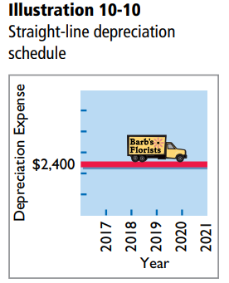
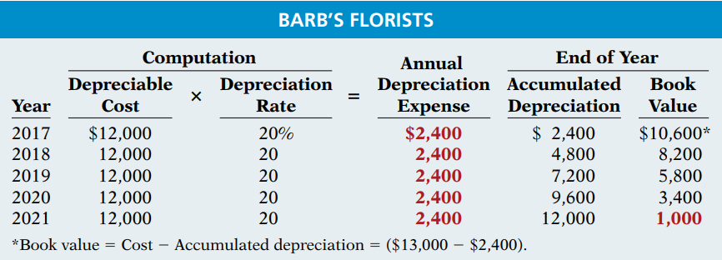

Slide 14
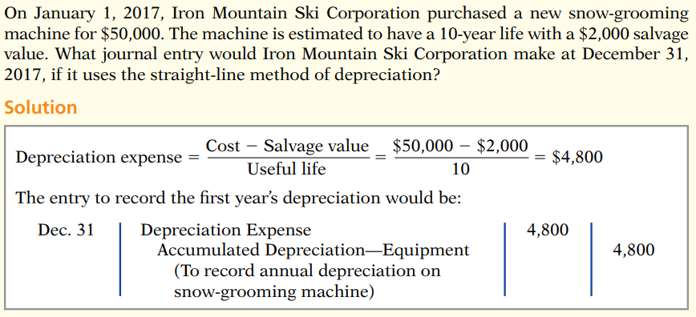

Slide 15
UNITS-OF-ACTIVITY METHOD
Under the units-of-activity method, useful life is expressed in terms of the total units of production or use expected from the asset, rather than as a time period. The units-of-activity method is ideally suited to factory machinery. Alternative Terminology Another term often used is the units-of-production method.
To illustrate, assume that Barb’s Florists drives its delivery truck 15,000 miles in the first year. Illustration 10-11 shows the units-of-activity formula and the computation of the first year’s depreciation expense.

Slide 16

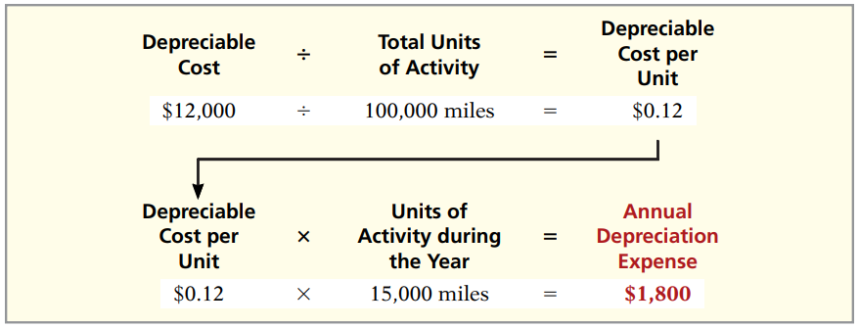

Slide 17
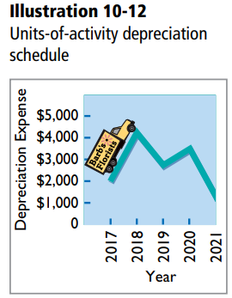
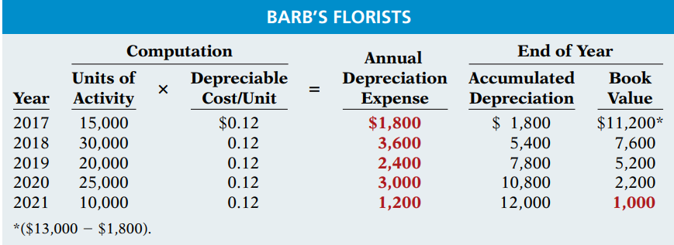
The units-of-activity depreciation schedule, using assumed mileage, is as follows.

Slide 18
DECLINING-BALANCE METHOD
The declining-balance method produces a decreasing annual depreciation expense over the asset’s useful life. The method is so named because the periodic depreciation is based on a declining book value (cost less accumulated depreciation) of the asset. With this method, companies compute annual depreciation expense by multiplying the book value at the beginning of the year by the declining-balance depreciation rate. The depreciation rate remains constant from year to year, but the book value to which the rate is applied declines each year.

Slide 19
A common declining-balance rate is double the straight-line rate. The method is often called the double-declining-balance method. If Barb’s Florists uses the double-declining-balance method, it uses a depreciation rate of 40% (2 * the straight-line rate of 20%). Illustration 10-13 shows the declining-balance formula and the computation of the first year’s depreciation on the delivery truck.

Slide 20

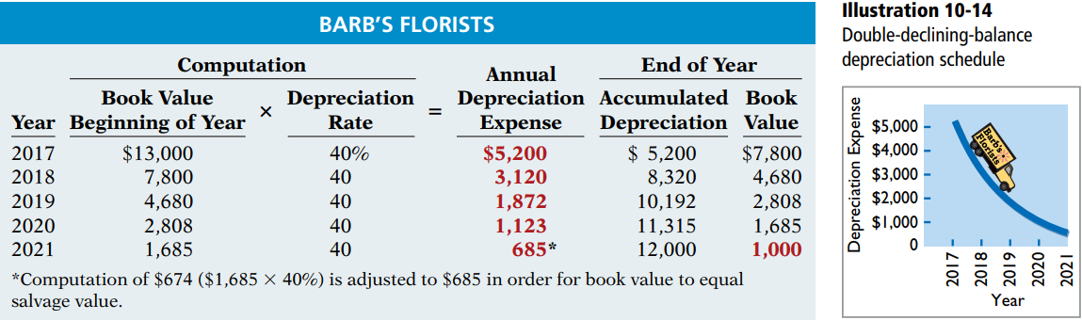
The depreciation schedule under this method is as follows.

Slide 21
The delivery equipment is 69% depreciated ($8,320 / $12,000) at the end of the second year. Under the straight-line method, the truck would be depreciated 40% ($4,800 / $12,000) at that time. Because the declining-balance method produces higher depreciation expense in the early years than in the later years, it is considered an accelerated-depreciation method.

Slide 22
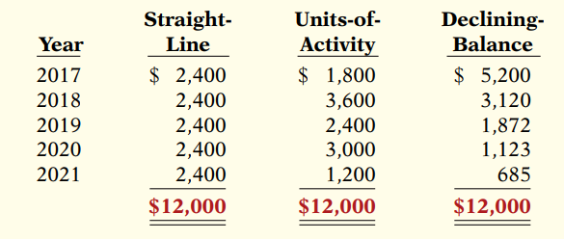
COMPARISON OF METHODS
Illustration below compares annual and total depreciation expense under each of the three methods for Barb’s Florists.

